Slide 1
The third week
Creating Your Own Game
Space Race!
Group B
Sytze (14597454), Bas (14598248), Lucas (14658887), Simon (13219715), Raven (13974920), Yifan (14614065), Owen (14621444), Michael (12405922), Ertugrul (13971832), Wessel (14445662), Tessa (14616025), Milou (14375915)

Slide 2
Achievements of this week
Player/Enemy
Boss fight
Classes
More Items: Potions, bombs
Player animations
Player respawn
World
Timed lasers
Portals
Better lighting
More custom rooms
Enhanced lobby mechanics
Better camera tracking
Networking
Sync fixes
Honorable mentions: Animating moving shuttle, basic camera follow system for (2v2) setup , improved gamelogic

Slide 3
Demo

Slide 4
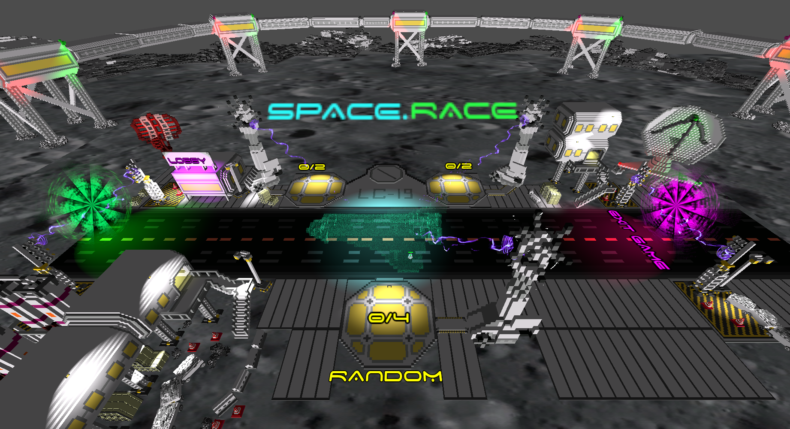
New Lobby Design

Slide 5
Next week
01
Bug fixes
Documentation
Sound effects
QoL
02
More custom rooms
More RMS scripts
Refactor entity spawning into a modular approach
Disconnect items between the two sides of the map
Allow easy connections between intractable and doors
03
Finalize classes
Finalize final boss
Finalize potions

Slide 6
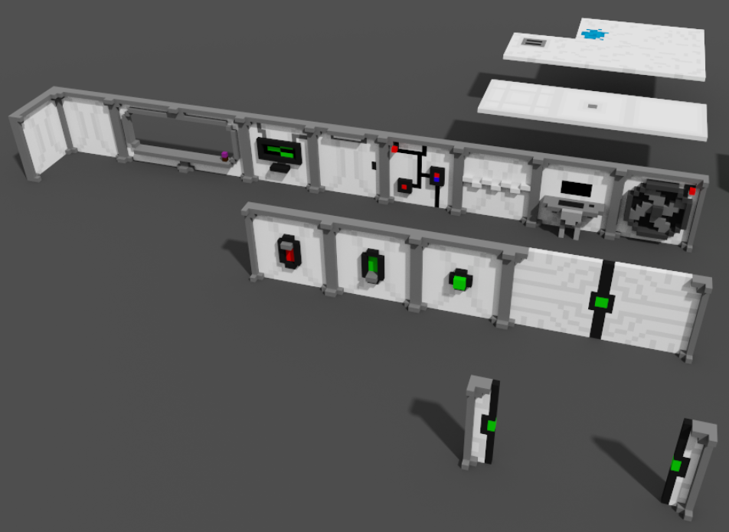
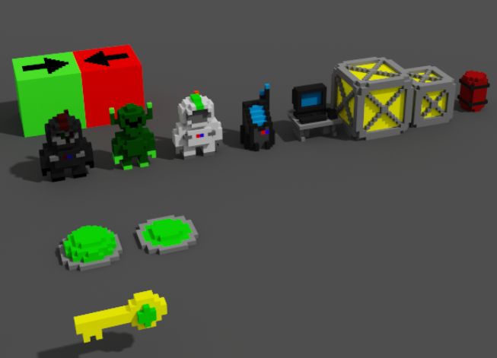
Questions?

